Slide 1
A Practical Tutorial for Jupyter Notebooks
Logan Ward
Postdoctoral Scholar
University of Chicago
17 October 2018

Slide 2

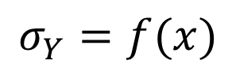
What is Materials Informatics
Another kind of computational materials science tool
Goal: Accelerate design of materials
Method: Replace experiments with computers
Many Theory-Based Tools:
Density Functional Theory
Phase Field
Finite Element Analysis
Computational Thermodynamics
Emerging Field: Data-driven Models
Materials
Data
Machine Learning
Predictive Model
$$σ_{Y}=f(x)$$

Slide 3
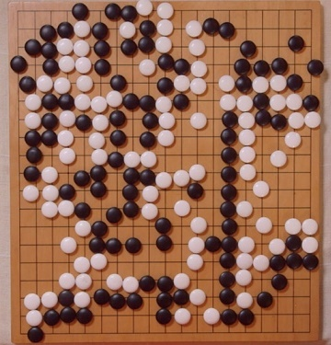
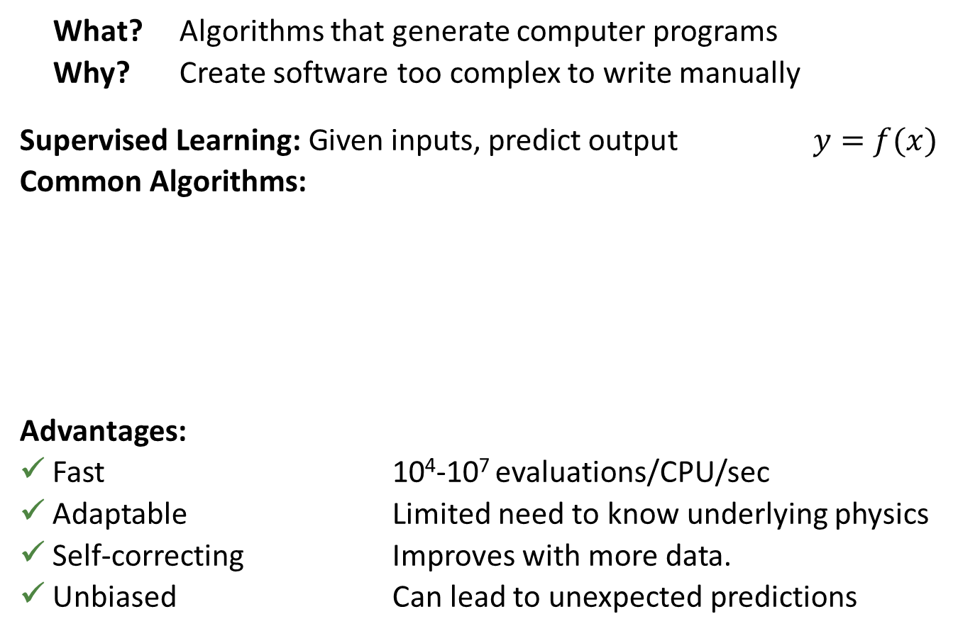
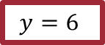
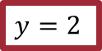
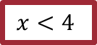
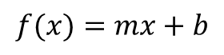
Machine Learning: What? Why?
What? Algorithms that generate computer programs
Why? Create software too complex to write manually
Supervised Learning: Given inputs, predict output $y=f(x)$
Common Algorithms:
Advantages:
✓ Fast 10⁴-10⁷ evaluations/CPU/sec
✓ Adaptable Limited need to know underlying physics
✓ Self-correcting Improves with more data.
✓ Unbiased Can lead to unexpected predictions
y
$$f(x)=mx+b$$
Linear Regression
Decision Trees
$$x<4$$
Neural Networks
$$y=2$$
$$y=6$$
x
Source: nature.com
Notes:
Supervised learning
Self-correcting: If the model’s wrong, add more data and it will automatically correct itself

Slide 4
Objectives
Goal: Pass on “lessons learned” from doing materials informatics
A Few General Questions:
How Should I Construct a Problem?
What Tools Are Available?
How Should I Organize My Project?
What About Publishing?

Slide 5
How to make/use ML models?
Practical concerns:
What tools should I use?
How should I avoid doing unneeded work?
How to make sure my science is reproducible?

Slide 6
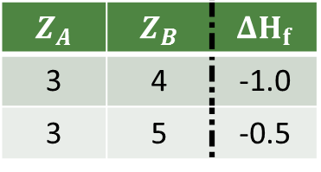
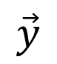
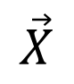
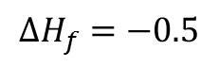
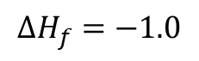
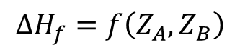
Materials Informatics Workflow
Collect
Process
Represent
Learn
$$\vec{X}$$
$$\vec{y}$$
$$ΔH_{f}=−1.0$$
$$Z_{A}$$ | $$Z_{B}$$ | $$ΔH_{f}$$
3 | 4 | -1.0
3 | 5 | -0.5
$$ΔH_{f}=f\left(Z_{A},Z_{B}\right)$$
$$ΔH_{f}=−0.5$$
Notes:
“What we eventually came up with was a 4 step process, which will also help explain the relevance of my thesis work.

Slide 7


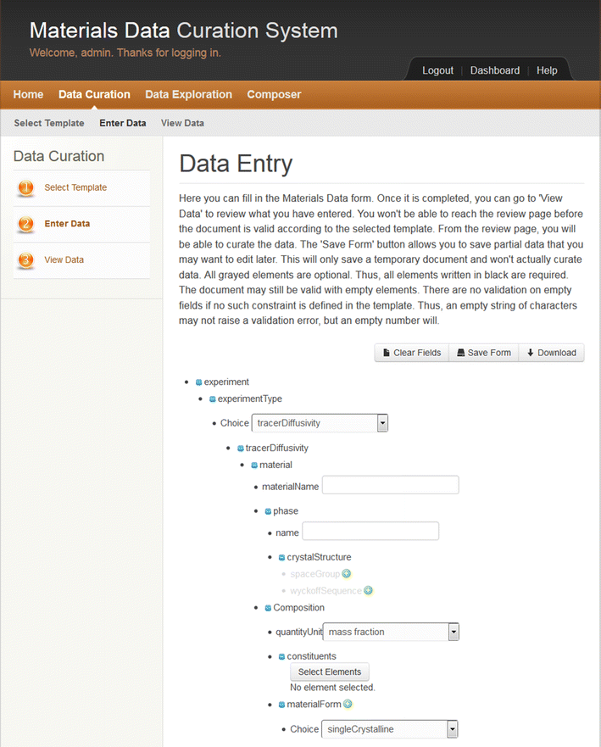

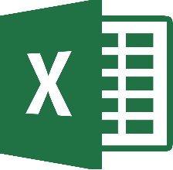







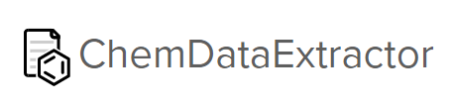
Data Collection and Processing
Collect
Process
Represent
Learn
Collect data, define training set
Challenge 1: Finding/storing structured datasets
Challenge 2: Clearly define inputs and outputs
LIMS Tools
Data Resources
NLP
Materials Commons
$$ΔH_{f}=−1.0$$
$$ΔH_{f}=−0.5$$

Slide 8
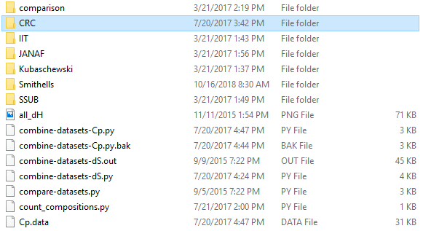
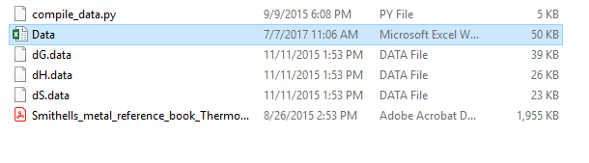
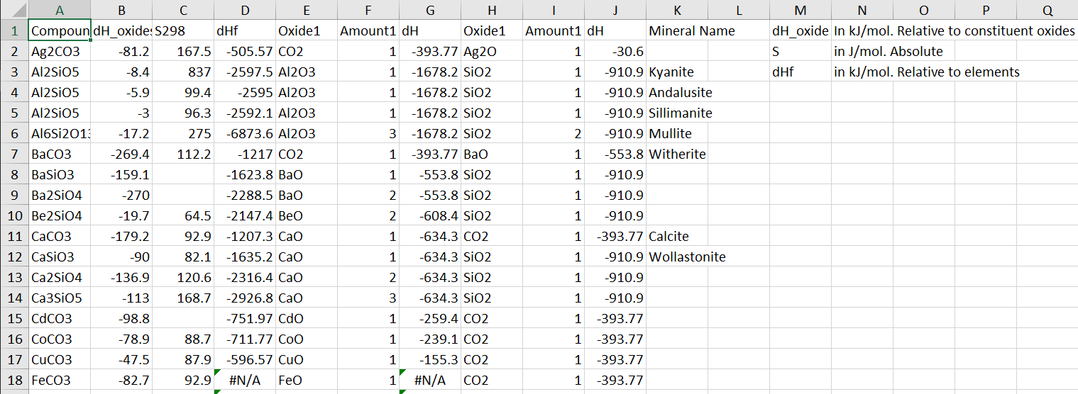
Data Management Need Not Be Fancy…
Write code to format data
(Don’t edit by hand!)
Knowing “what you have” and “where you got it” should not rely on memory

Slide 9
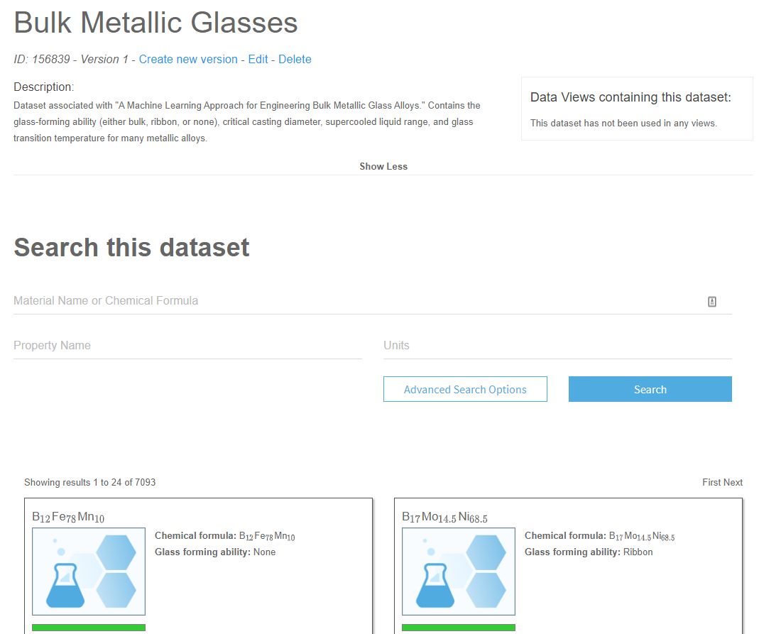


…but There Are Modern Tools
Common Data Curation System
Citrination
Organizing your data provides a solid starting point

Slide 10
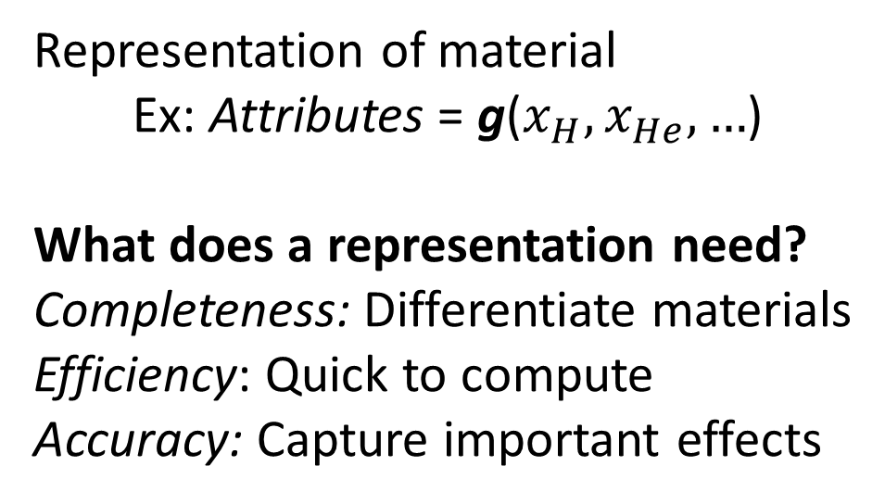
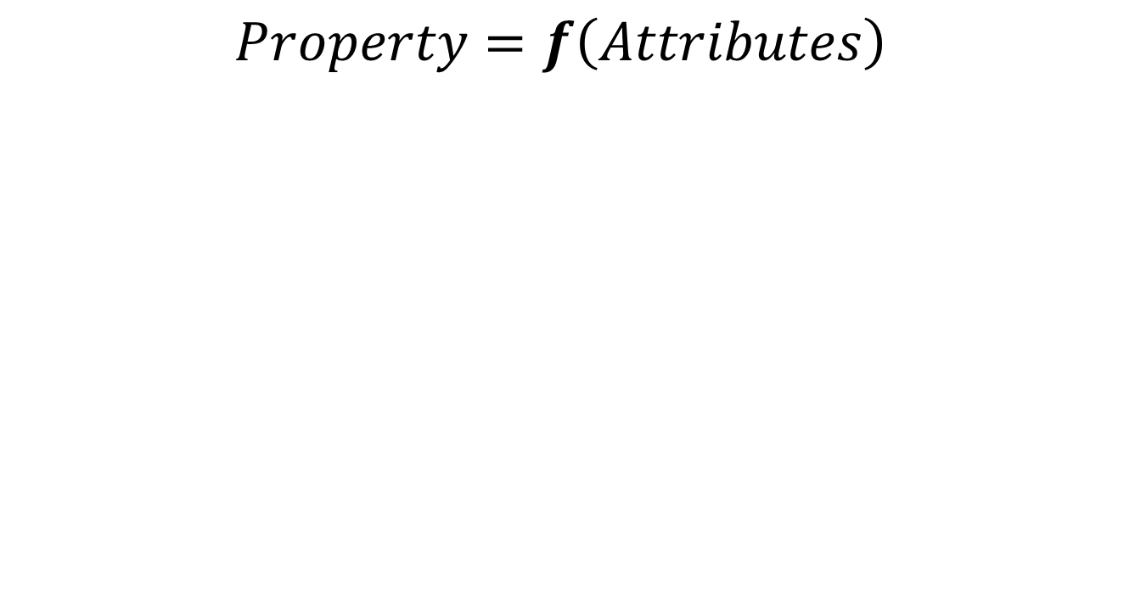
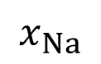
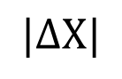
Data Representation
Collect
Process
Represent
Learn
Encode domain knowledge into inputs
$$Property=f\left(Attributes\right)$$
NaPb
Na₂O
LiF
Representation of material
Ex: Attributes = g($x_{H},x_{He},…$)
What does a representation need?
Completeness: Differentiate materials
Efficiency: Quick to compute
Accuracy: Capture important effects
$$|ΔΧ|$$
$$x_{Na}$$
LiF
NaPb
Na₂O
End product: Machine-learning compatible inputs

Slide 11
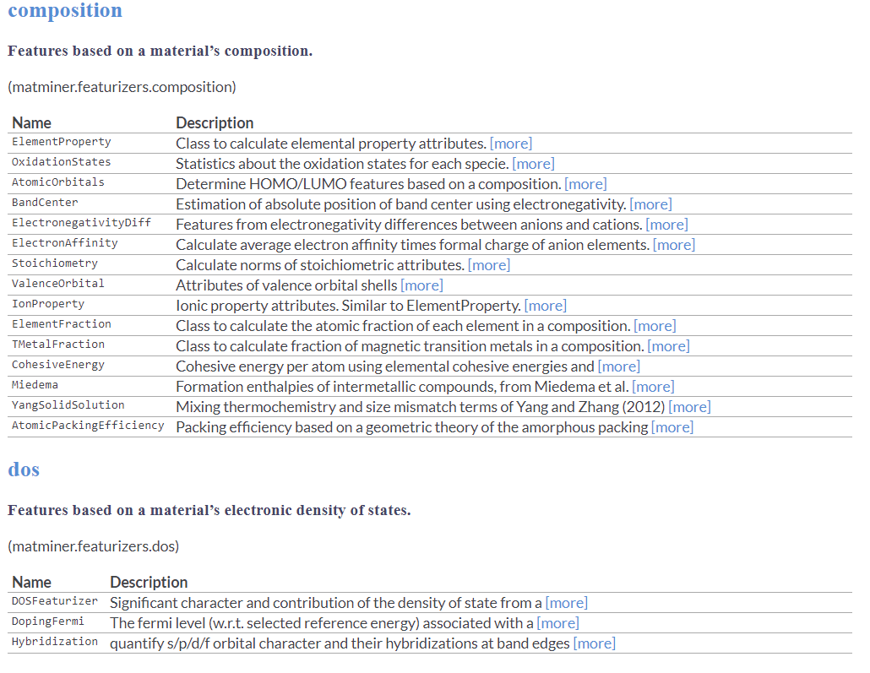
Matminer: “Featurizer” Library
Matminer has methods from many groups

Slide 12
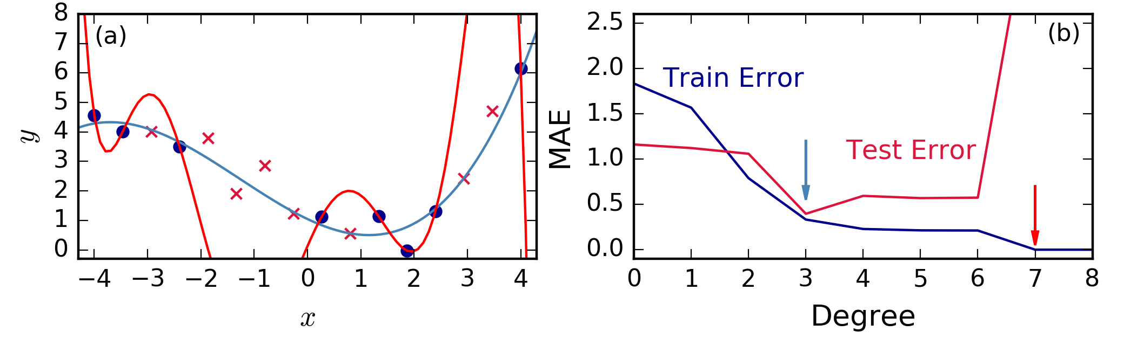
Fit a model to the data
Collect
Process
Represent
Learn
There are many algorithms, how do you decide?
Identify algorithms with desired properties. Ex: differentiability
Use cross-validation to optimize parameters
Pick the one with the lowest “loss”
Numpy
Scipy
Scikit-learn
Theano
TensorFlow
Keras
PyTorch
Pandas
Matplotlib
Notes:
Companies with ML platforms available to users
AmazonSageMaker
IBM
Uber

Slide 13
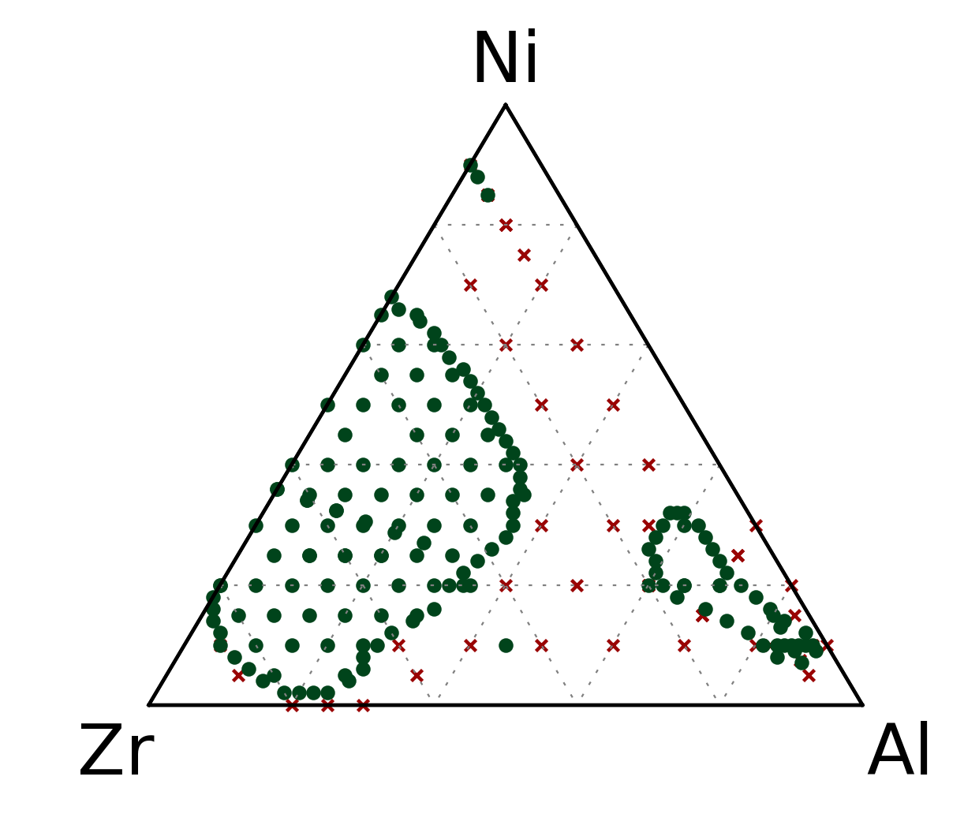
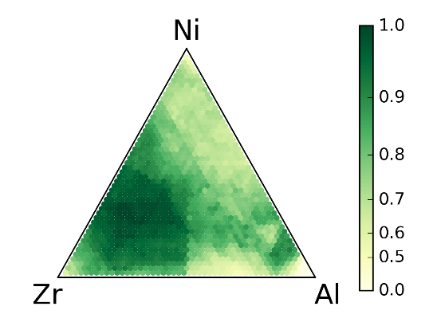
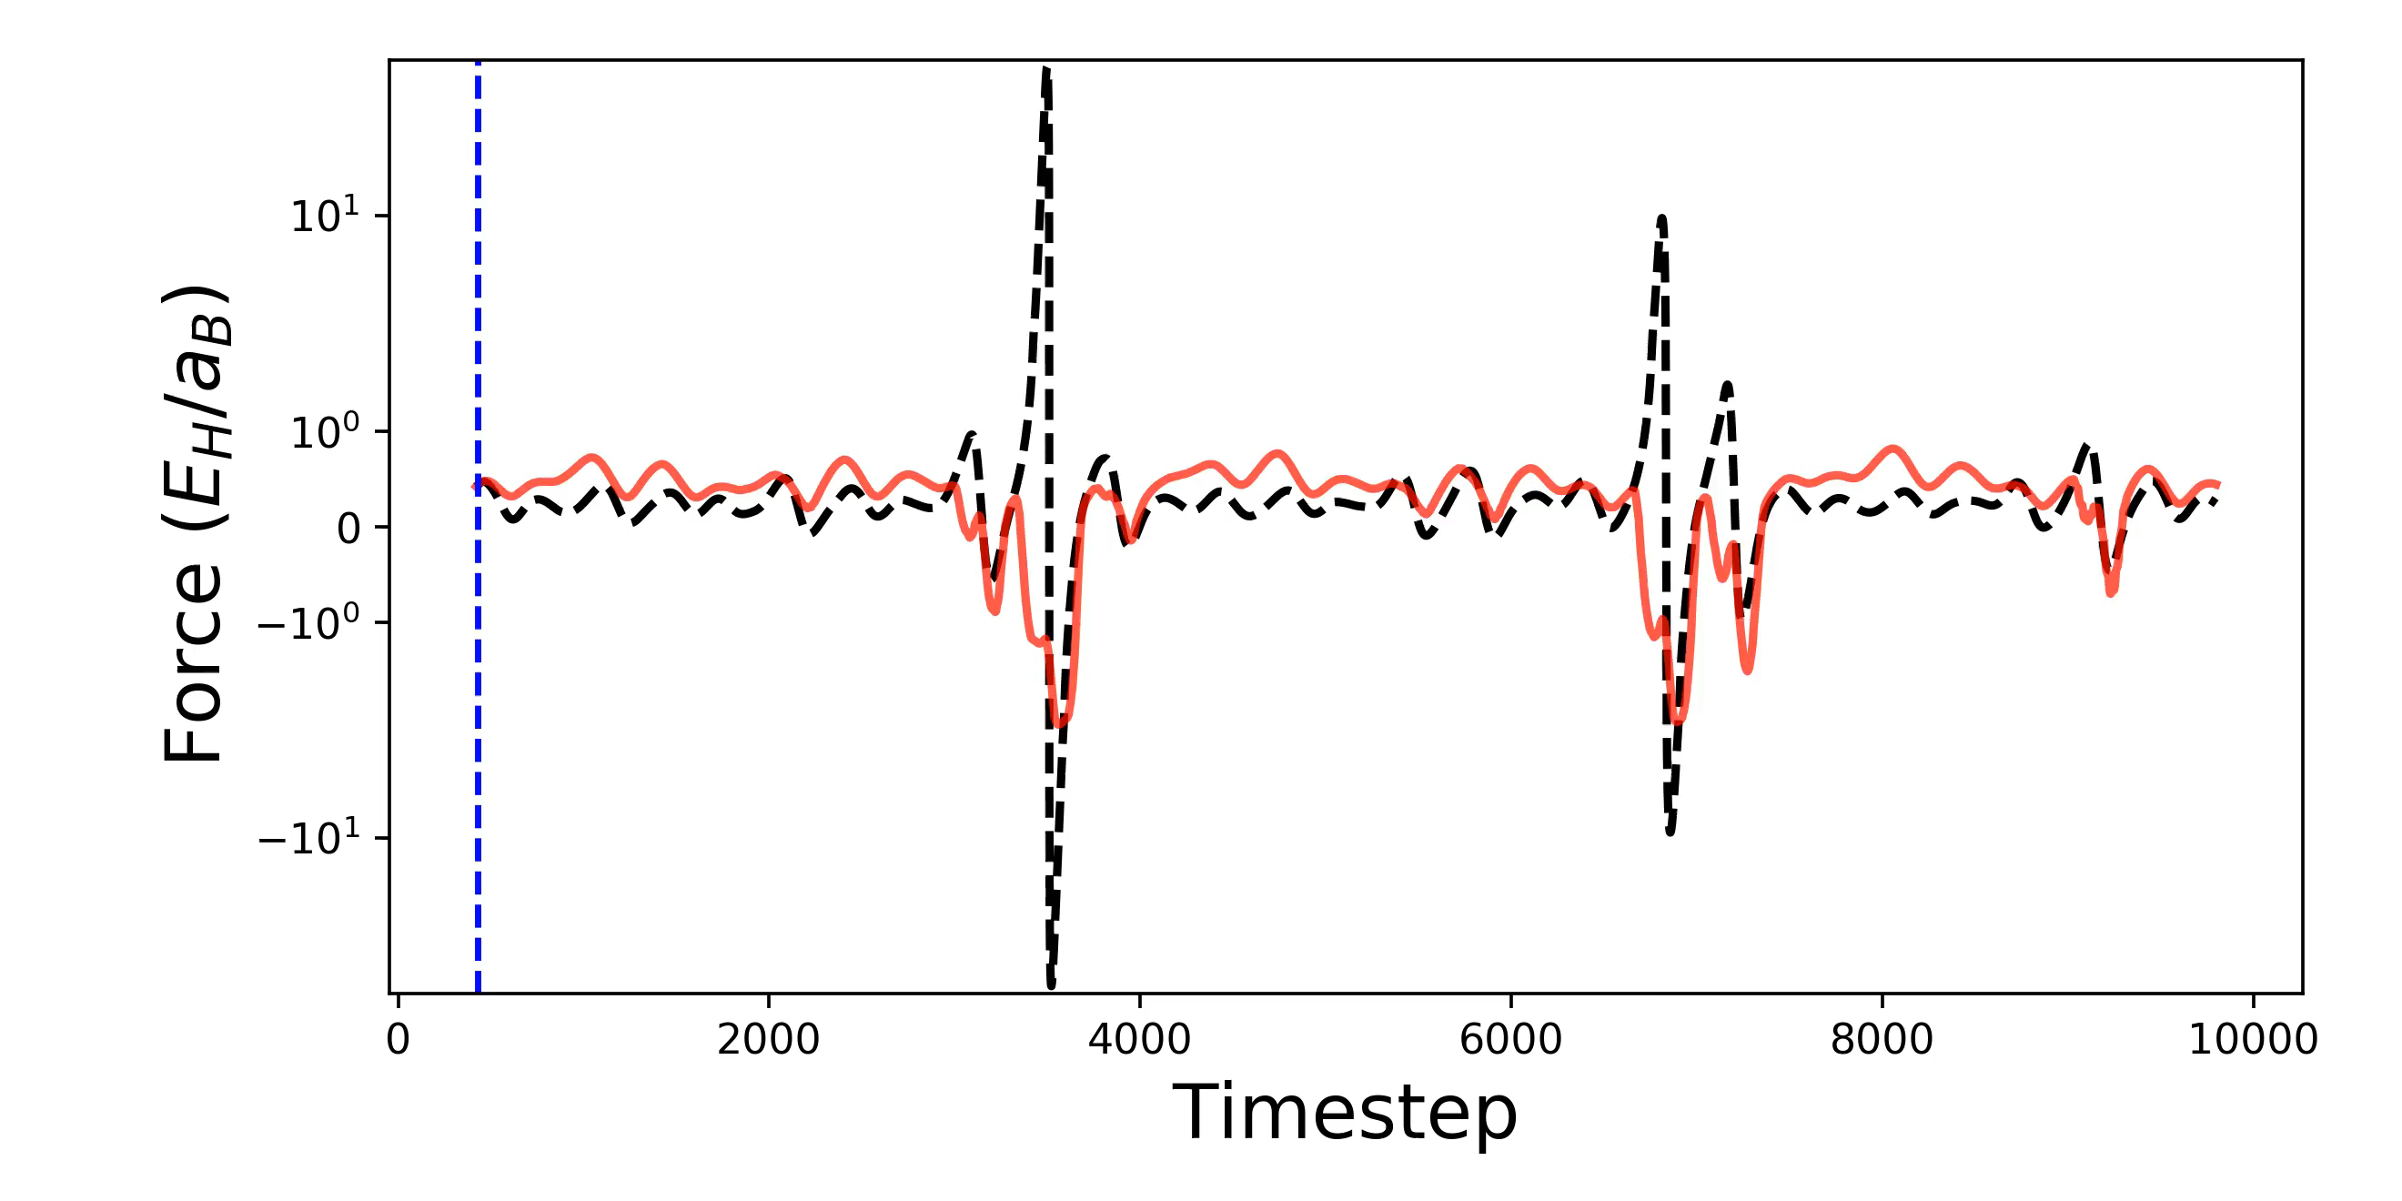
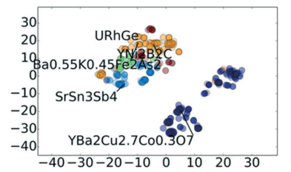
Think Hard About Validation
Test Model How You Will Use It
Evaluating new alloy systems?
Exp.
ML
Predicting Future Events?
Ward et al. npj Comp Mat. (2016)
Interpolating to new clusters?
Ward et al, in preparation
Meredig et al. MSDE. (2018)

Slide 14
How to Organize? [Jupyter]
Notes:
You now know the general flow of a project.

Slide 15
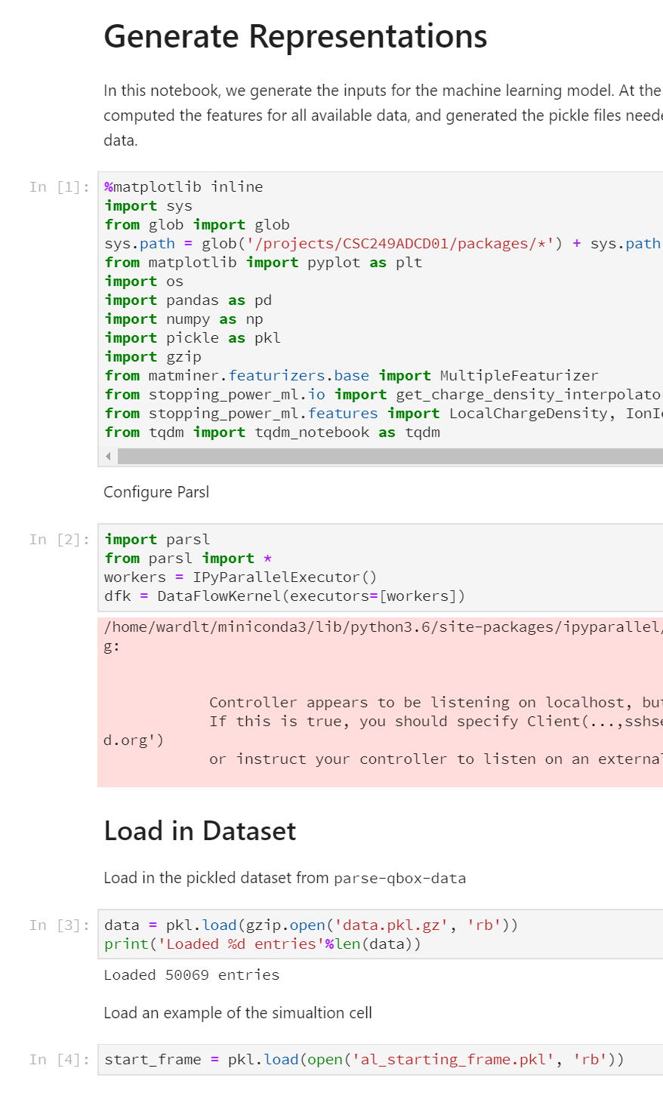

What is Jupyter? Why care?
Jupyter is environment designed for reproducible computational science
Stores code with outputs and documentation in a single notebook
Modeled after Mathematica
https://www.theatlantic.com/science/archive/2018/04/the-scientific-paper-is-obsolete/556676/
Why do I care? Jupyter lets me…
organize my code
easily run on a remote system
keep track of results and rationale
communicate my research better

Slide 16
How I write a notebook
One notebook per “experiment” or “idea”
Outline:
Title and short abstract
“What am I doing here and why”
Load in libraries
Put them up front, so it crashes early
Load in data from disk
Ex: training data, results from other notebook
Each step in their own block
Introduction
Code and explanation
Figure/visualization
Explanation of finding

Slide 17
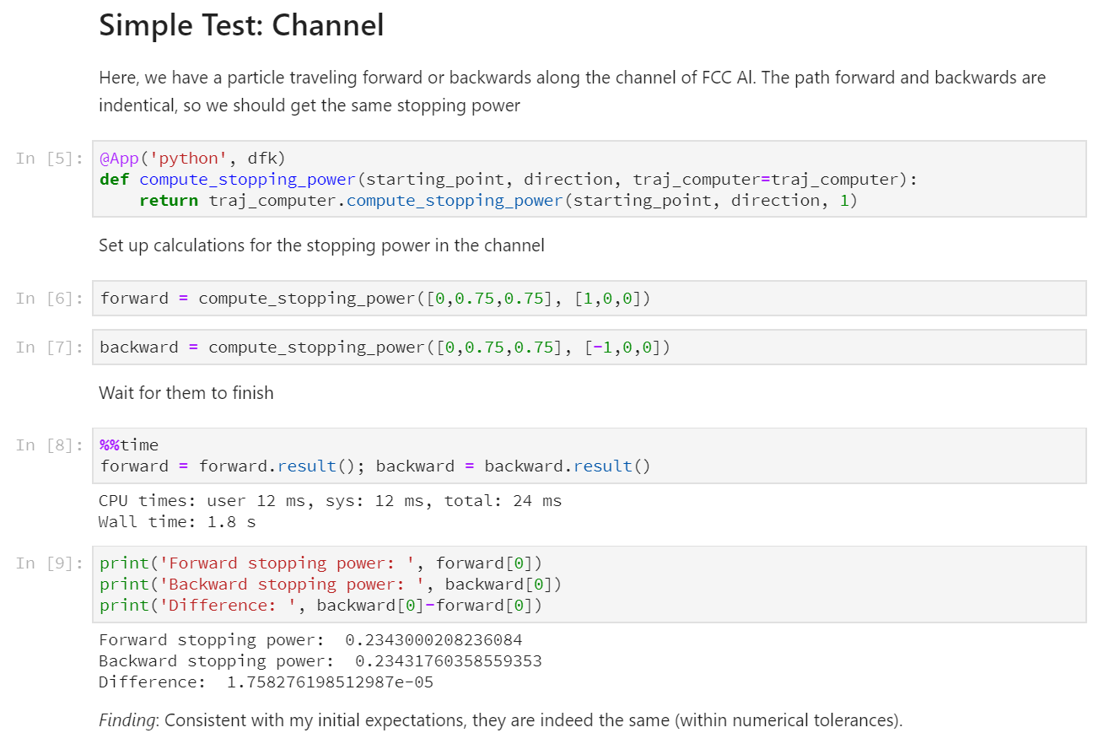
Example Step
Introduction
Explanation
Visualization and conclusion
Someone should be able to understand this without knowing Python!

Slide 18
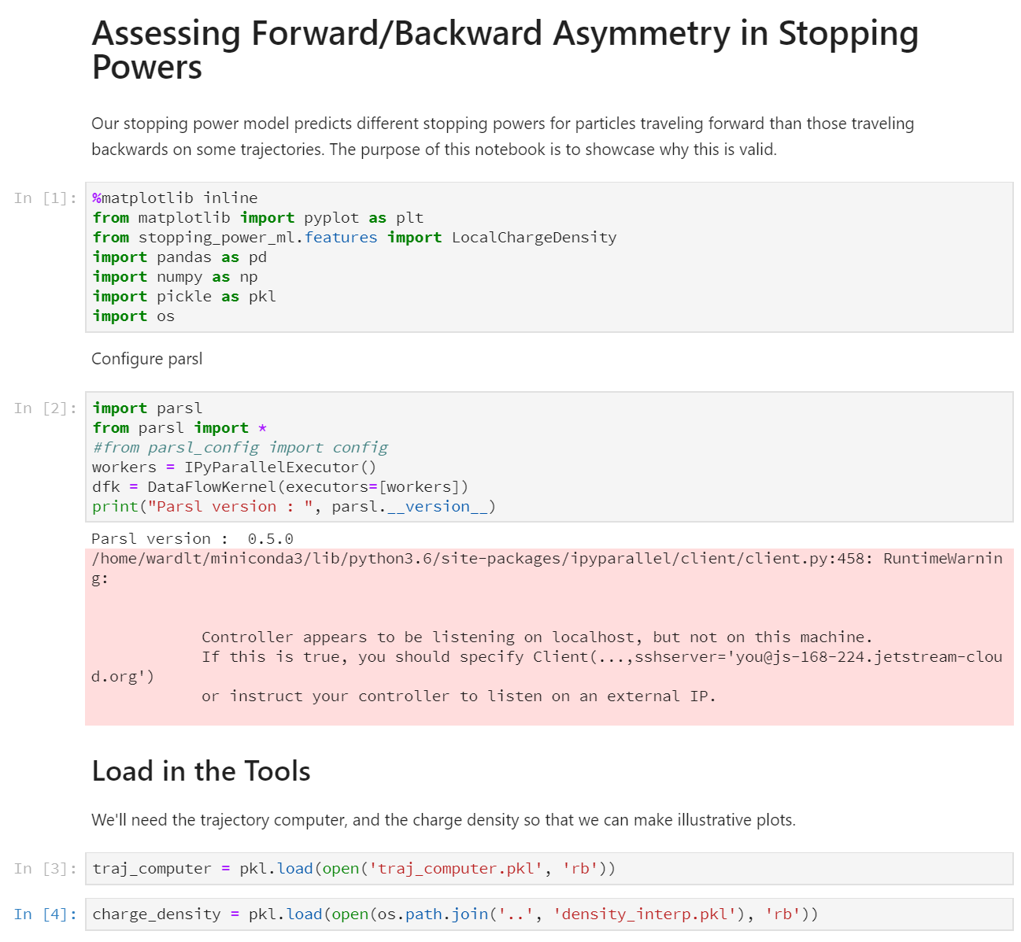
The Full Narrative
Link to GitHub Page

Slide 19
Pitfalls When Making Notebooks
Not including documentation
Advice: Write what you’re going to do first
Notebook not capturing entire process
Problem: Jupyter lets you execute cells out of order
Advice: Periodically “Restart Kernel and Run All Cells”
Duplicate code between notebooks
Advice: Make a separate module for common code
Library conflicts
Advice: Run mature projects in container, separate machines
Advice: Make a “requirements.txt” file
The “one cell notebooks”
Advice: <10 lines of code per cell

Slide 20
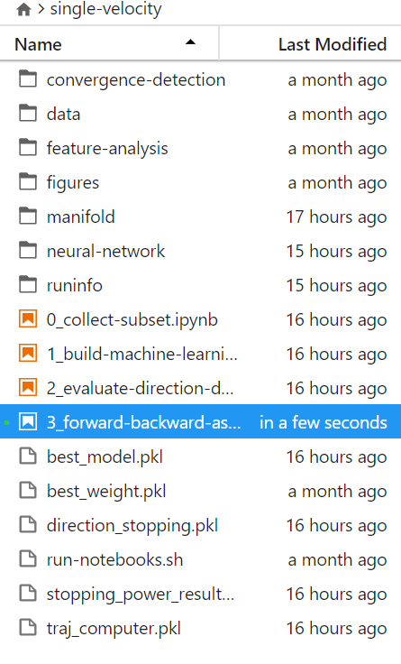
Organizing Multiple Notebooks
Re-usable datasets in separate folder
Figures in separate folder (with meaningful names!)
(making pub-ready figures!)
Dependent tasks in separate folder
Notebooks numbered by execution order
Results shared between steps using pickled files
A bash script to re-run all notebooks

Slide 21
Running Notebooks from Terminal
#! /bin/bash
# This script just runs through all of the current notebooks in the proper order
runJupyter() {
jupyter nbconvert --execute --inplace --ExecutePreprocessor.timeout=-1 $1
}
# If we get too many files, we should probably create a file containing
# names of notebooks and the order in which they should be executed
for n in `seq 0 1`; do
runJupyter ${n}_*nb
done
Rerun your project often, put in “assert” statements for key results!

Slide 22
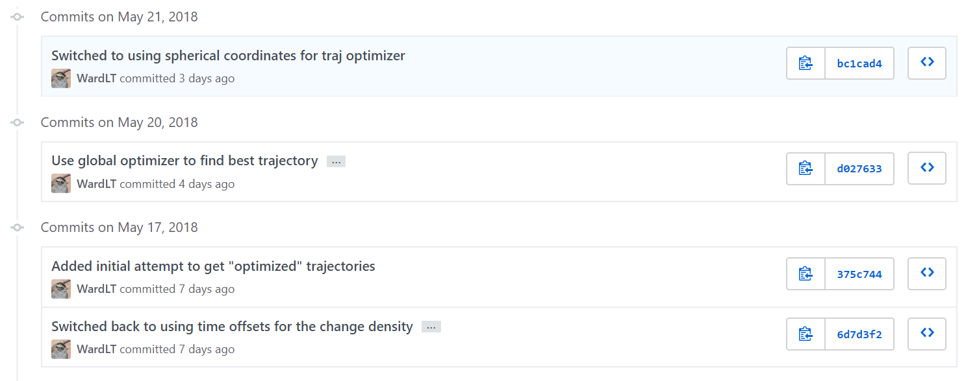
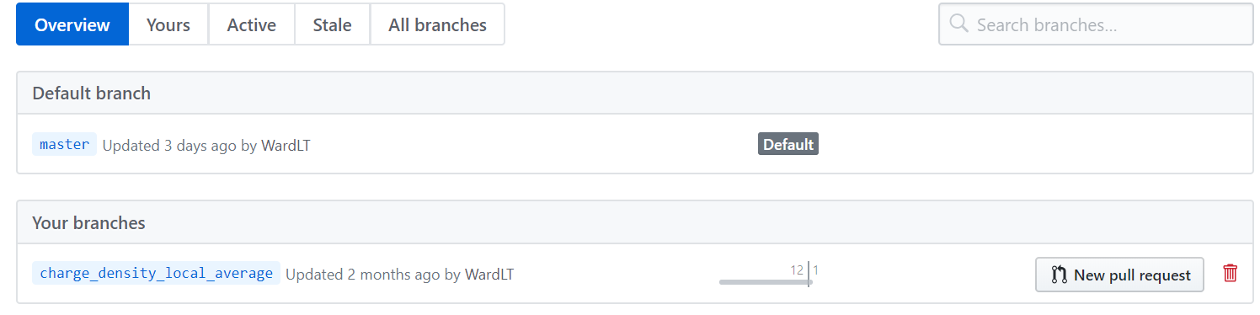
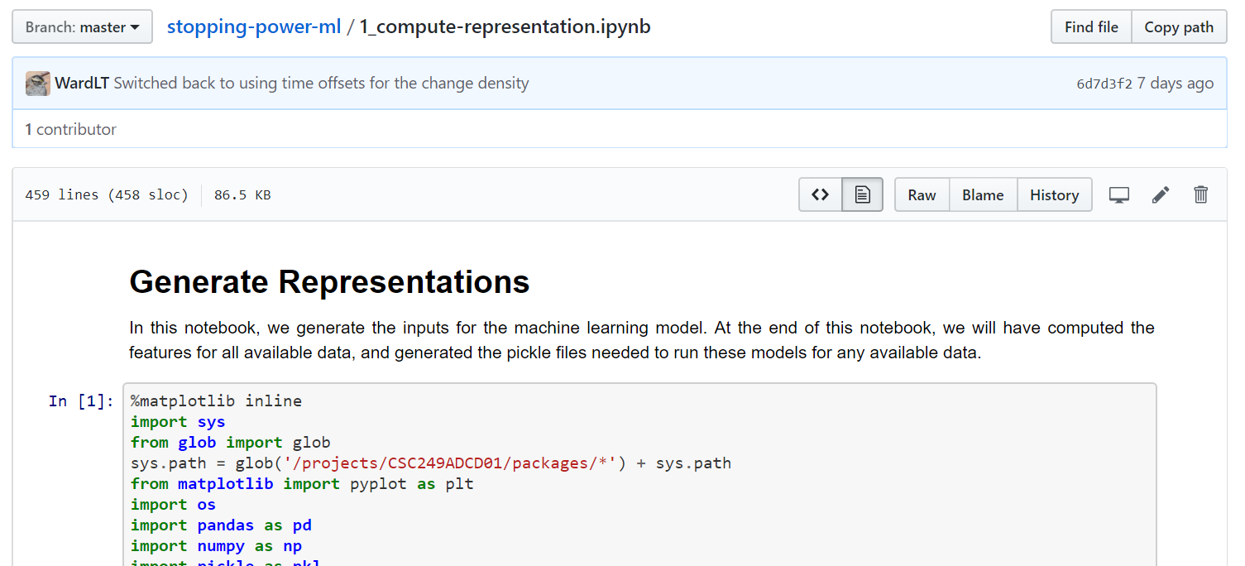
Keeping Track of Project
Use GitHub to track changes
Make branches for dead-ends
GitHub renders your notebooks:
Great for Sharing with Collaborators!

Slide 23
Take-Away Points
Write your notebooks like papers
Explain what you are doing, why, and what you found
Learn Markdown to include links, equations, pictures
Break up complex projects into multiple steps
Each notebook should tell a single story
Notebooks should be easy to re-run
Use “Restart and Run,” bash scripts
Track your changes with Git
Explain what changes you made, and why

Slide 24
Publication: Not Just Papers

Slide 25
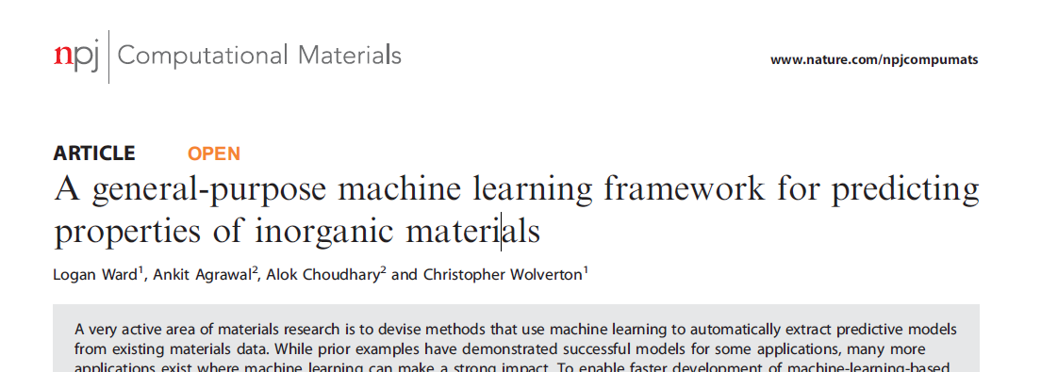
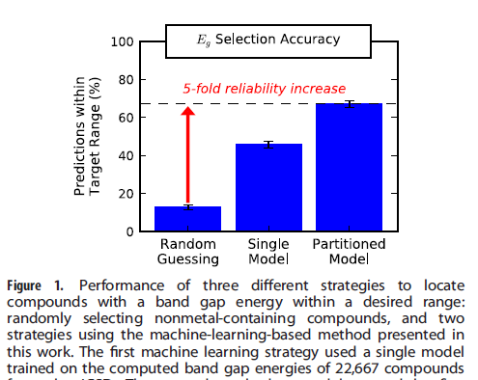
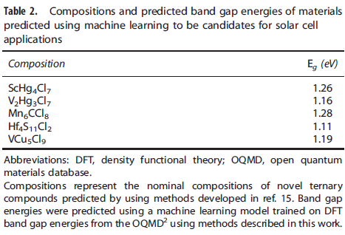
Is my 2016 paper reproducible?
Predicted Materials
Method Comparison

Slide 26
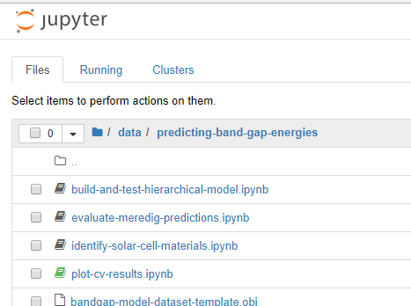
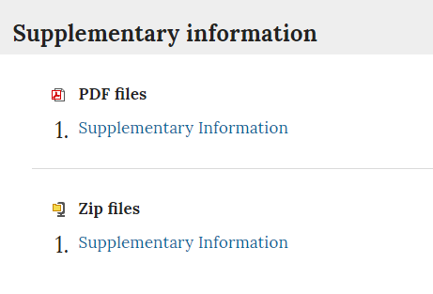
I released the code, but not all of it
From Original Source Code
… to New Notebooks

Slide 27
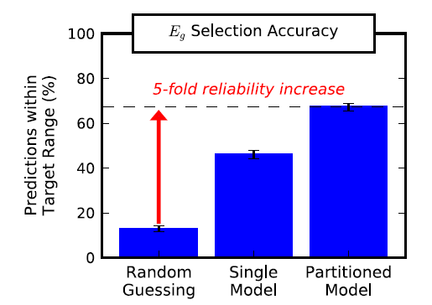
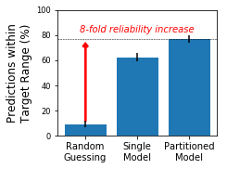
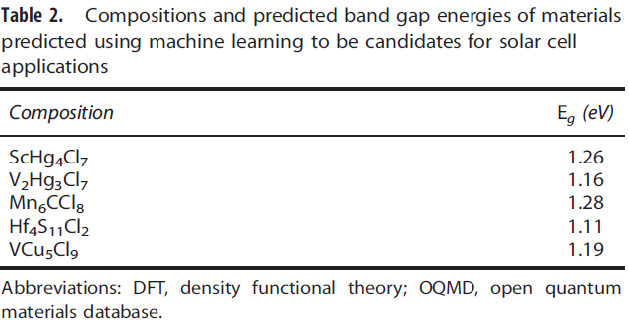
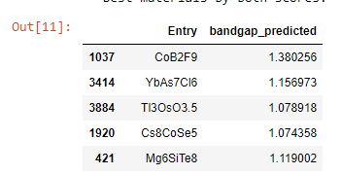
… and there are differences
Reported Results in 2016(?)
Replication in 2017
Without Exact Scripts From <2016, Cannot Verify Results
Publication Should Go Beyond the Paper!

Slide 28




How Do We Avoid this Problem?
What do I need to publish?
Datasets: In a well-described format
Scripts: Not just the core methods
Outputs: Exact version from the paper
Models: In a user-friendly way
WholeTale
DLHub

Slide 29





“Take Home” Messages
Tools Exist for All Parts of Informatics Workflow
Jupyter Can Make Work Communicable, If Careful
Publishing Should Go Beyond Papers

